Slide 1

Analysis of Crypto Currency Growth in last 5 year
MALLADI NARENDRA

Slide 2

PROBLEM STATEMENT
Analyze the growth and evolution of cryptocurrencies over the past five years ,containing columns for cryptocurrency name, symbol, date, open price, closing price, high price, low price, market capitalization, and trading volume. The objective is to explore trends, patterns, and relationships within the data to gain insights into the cryptocurrency market's evolution over time.

Slide 3
Project Description
The dataset encompasses historical information spanning the past five years, featuring columns such as cryptocurrency name, symbol, date, open price, closing price, high price, low price, market capitalization, and trading volume. The primary objective is to leverage Power BI's capabilities to uncover trends, patterns, and insights within the cryptocurrency market.
Data Import and Cleaning:
Import the cryptocurrency dataset into Power BI.
Clean and preprocess the data to ensure consistency and reliability. Address issues such as missing values, duplicates, and data type formatting.
Data Modeling:
Design a robust data model in Power BI to facilitate efficient querying and analysis.
Create relationships between relevant tables to enable seamless data exploration.
Exploratory Data Analysis (EDA):
Generate interactive visualizations such as line charts, bar charts, and scatter plots to explore trends over time and relationships between variables.
Time Series Analysis:
Implement time intelligence functions in Power BI to analyze trends in cryptocurrency prices (open, close, high, low) and market capitalization over the past five years.
Calculate key performance indicators (KPIs) like daily price changes, volatility measures, and trading volume trends.

Slide 4

WHO ARE THE END USERS?
Investors and Traders
Financial Analysts and Researchers
Business Executives and Strategists
Academic Institutions and Students
General Public and Enthusiasts
Regulators and Policy Makers

Slide 5

Technology Used
The context of conducting a cryptocurrency analysis project using Power BI, several key technologies and tools are typically involved:
Power BI:
Description: Power BI is a business intelligence tool developed by Microsoft. It provides capabilities for data visualization, interactive dashboards, and business analytics.
Usage: Power BI is used for importing, cleaning, modeling, and visualizing data from various sources, including Excel, CSV files, databases, and online services.
Microsoft Excel:
Description: Excel is commonly used for initial data preparation and formatting before importing into Power BI.
Usage: Data from Excel spreadsheets can be imported into Power BI for cleaning, transformation, and analysis.

Slide 6
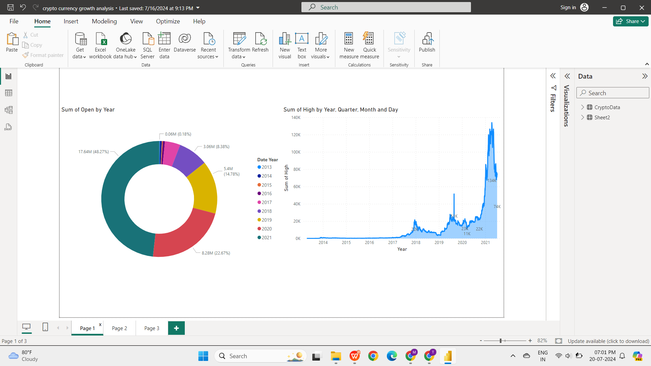
RESULTS
https://github.com/MALLADINARENDRA/Analysis_of_Crypto_Currency_Growth-_in_last_5_year

Slide 7
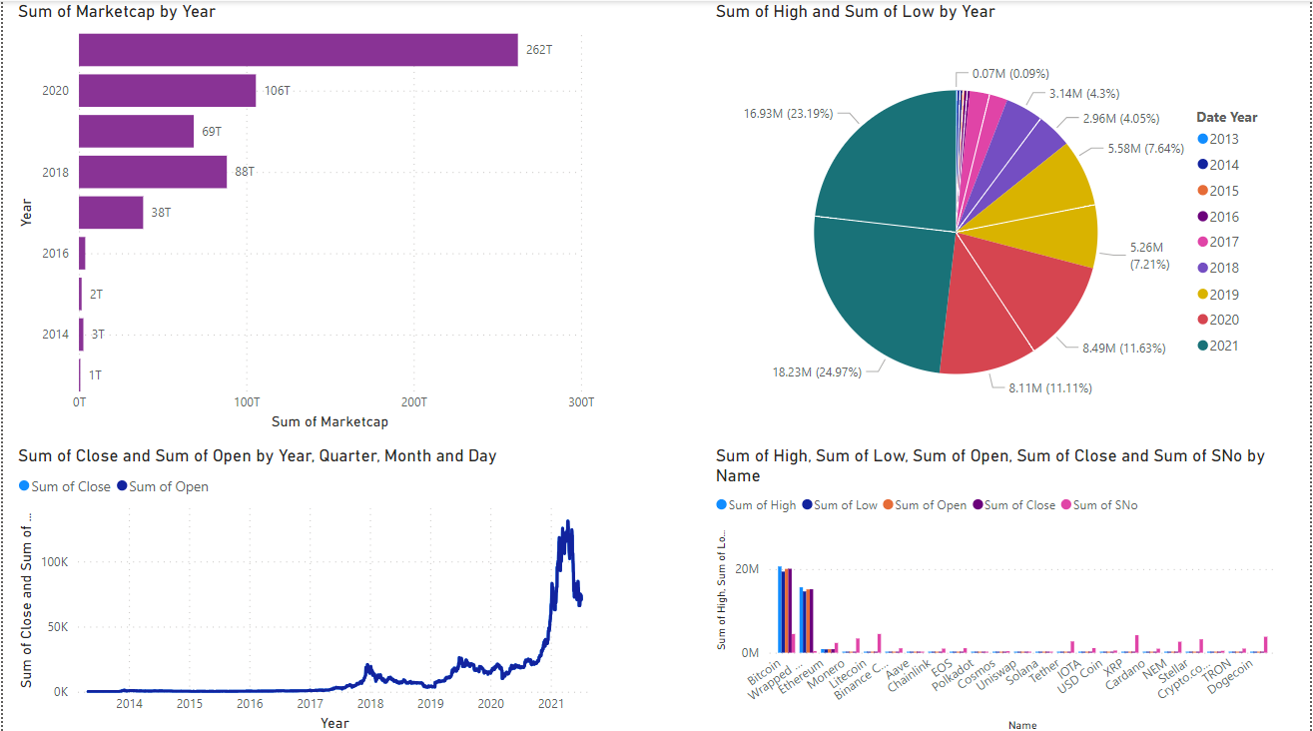

Slide 8
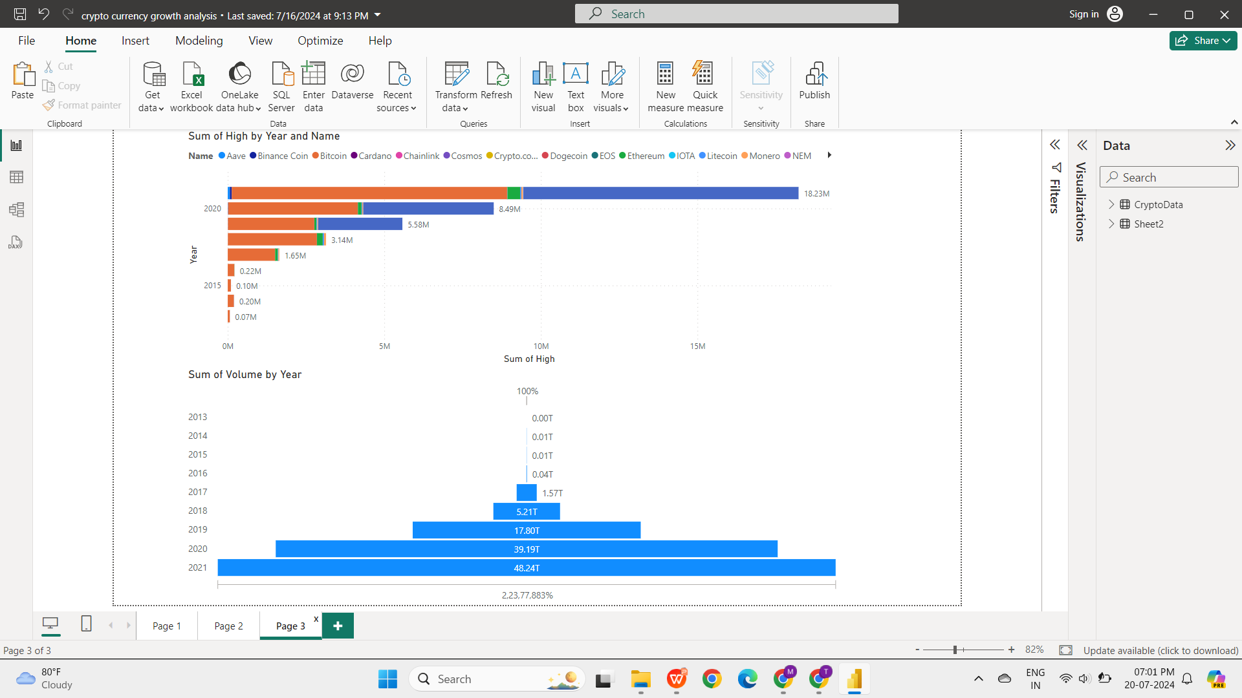

Slide 9
See my work on GitHub::
https://github.com/MALLADINARENDRA/Analysis_of_Crypto_Currency_Growth-_in_last_5_year
.
.

Slide 10


